Slide 1

CSC 2400 — Final Project
Shortest Path
Analysis
David Slate Lee
AJ Wood
Kai Matton
Connor Buttrey

Slide 2
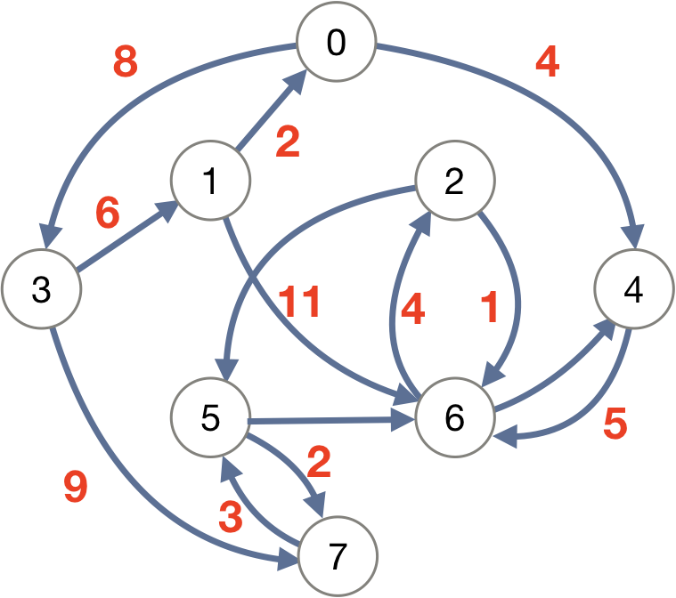
Project Overview
Project goal: test, compute, and compare shortest path algorithms on large-scale, real-world road network graphs.
We chose a graph of the New York City road network.
We chose to implement four distinct shortest path algorithms.

Slide 3
Dataset Overview
8 a 1 2 803
9 a 2 1 803
10 a 3 4 158
11 a 4 3 158
12 a 5 6 774
13 a 6 5 774
14 a 7 8 1531
15 a 8 7 1531
16 a 9 10 1673
17 a 10 9 1673
18 a 9 11 1400
19 a 11 9 1400
20 a 1 12 842
21 a 12 1 842
22 a 2 13 591
23 a 13 2 591
…
Data from DIMACS Challenge Graphs
.gr file which contains a graph representing the New York State road network.
Graph type: directed and weighted, contains 264,346 nodes and 733,846 arcs.
The graph is large, but not too large for modern computers. Ideal for algorithm benchmarking.

Slide 4
Dataset Overview
8 a 1 2 803
9 a 2 1 803
10 a 3 4 158
11 a 4 3 158
12 a 5 6 774
13 a 6 5 774
14 a 7 8 1531
15 a 8 7 1531
16 a 9 10 1673
17 a 10 9 1673
18 a 9 11 1400
19 a 11 9 1400
20 a 1 12 842
21 a 12 1 842
22 a 2 13 591
23 a 13 2 591
…
“Node 5 > node 6, with a weight of 774.”
Some edges appear twice in opposite directions.
Weights are physical distances in meters.
Coordinates dataset showing latitude and longitude.
v 1 -73530767 41085396
v 2 -73530538 41086098
v 3 -73519366 41048796
v 4 -73519377 41048654
v 5 -73524567 41093796
…

Slide 5
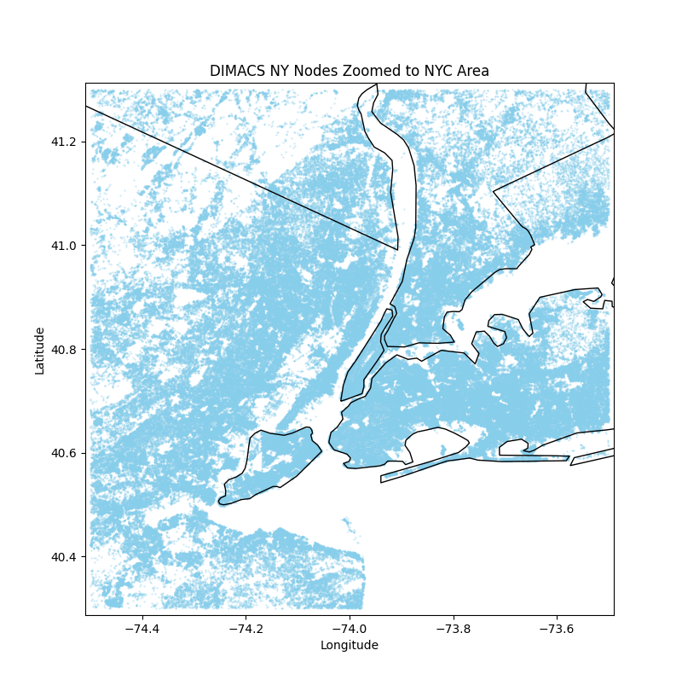
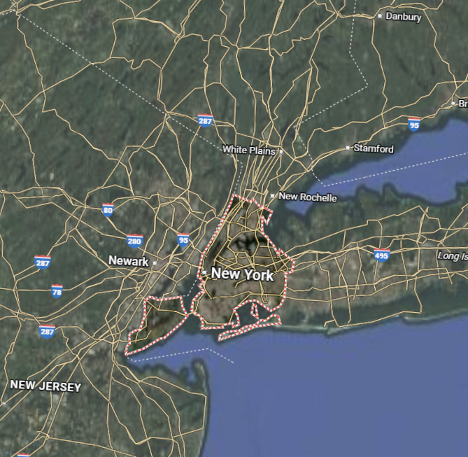

Slide 6

Dijkstra’s Algorithm
Edsger W. Dijkstra published his algorithm in 1959.
Find shortest path between nodes in weighted graph.
Dijkstra’s algorithm maintains a set of visited nodes and uses a priority queue to select the unvisited node with the smallest distance.

Slide 7
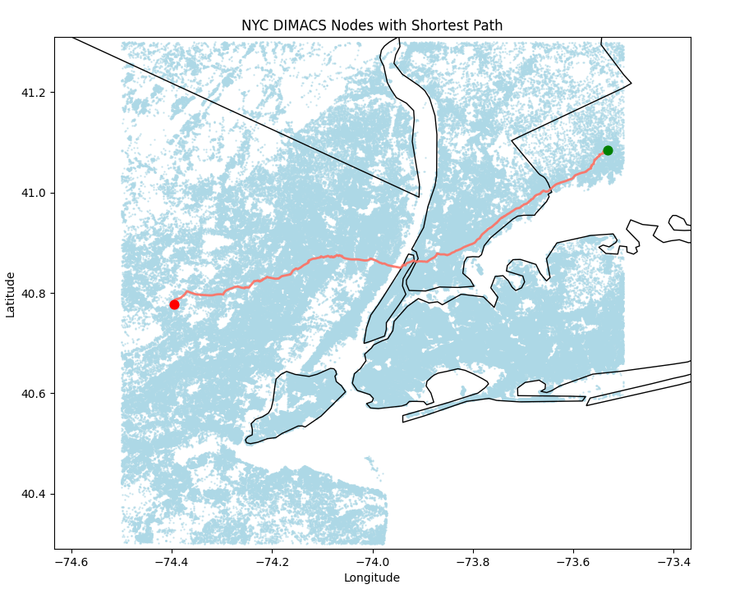
Dijkstra’s Algorithm
Shortest distance between node 1 and 200 was found in 0.07419 seconds.
Shortest distance between node 1 and node 100,000 in 0.8495 seconds.
This path is 955.712 km (593.409 miles). The location is Morristown to Stamford.

Slide 8
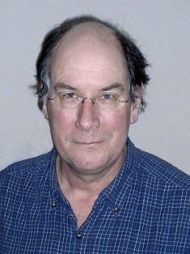
A* Algorithm Explanation:
Peter Hart is one of the inventors of the algorithm at SRI (stanford research institute) and worked on pathfinding in 1968
A* wants to find the lowest-cost path from start to goal node in a weighted graph. Uses heuristics (estimations) to guide the search
Uses g(n) + h(n) = f(n)
g(n): cost from start to current node
h(n): Heuristic estimate from current node to goal (not exact)
f(n): total cost of cheapest path

Slide 9
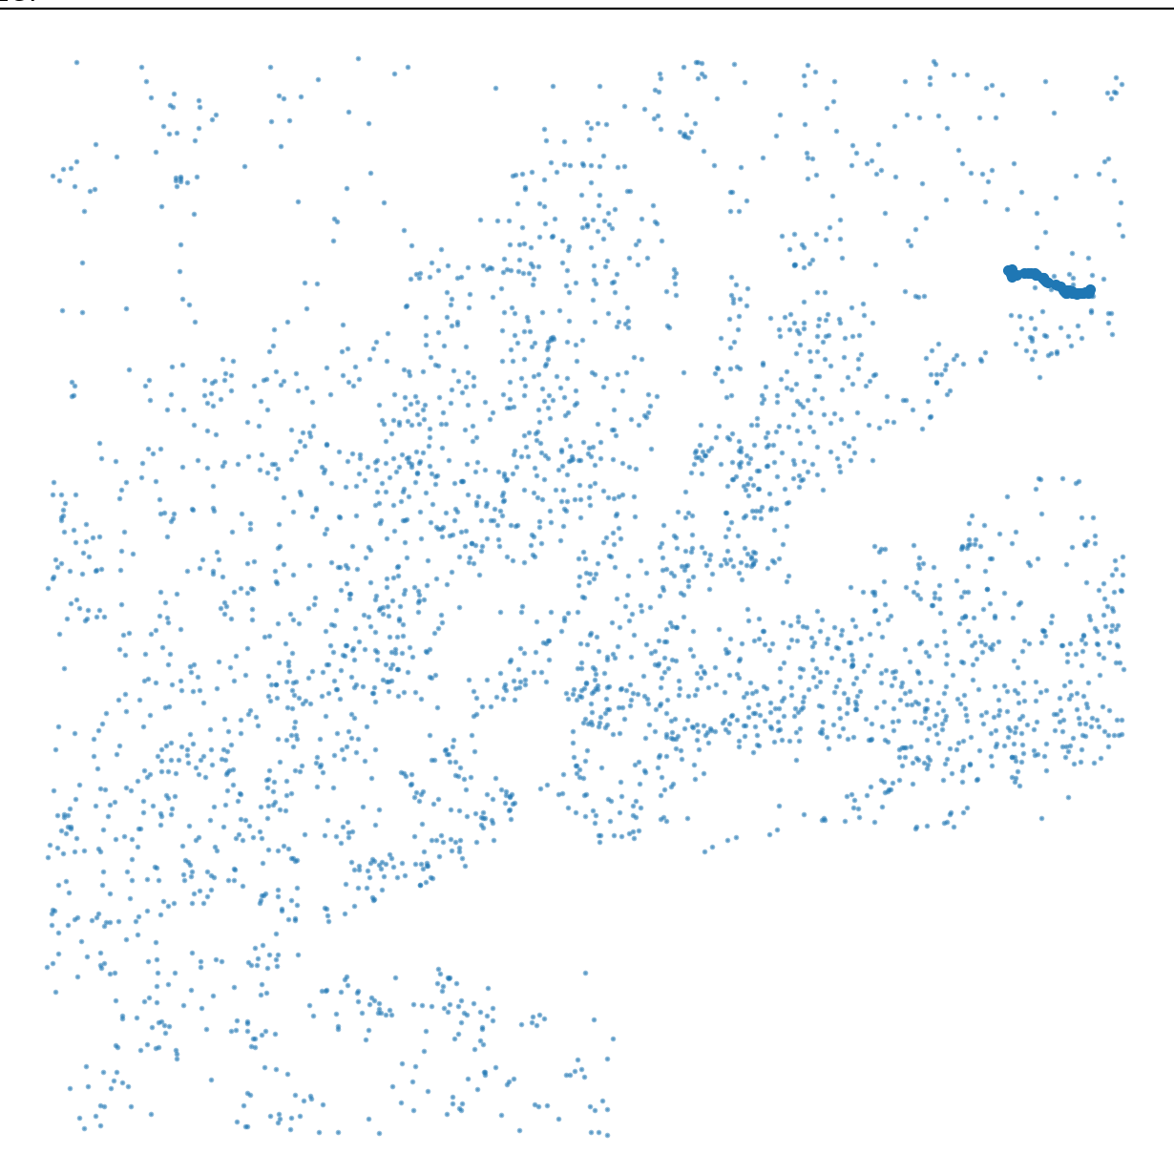
A* Algorithm Results:
Short path:
Start node: 1
End node: 200
Path length (in nodes): 47
Total path cost: 88037.0
Time taken: 0.001470 seconds
Analysis:
Since nodes 1 and 200 are extremely close geographically, it took little time to discover the lightest path. The incredibly fast runtime shows how efficient A* can be when it comes to local pathing.

Slide 10
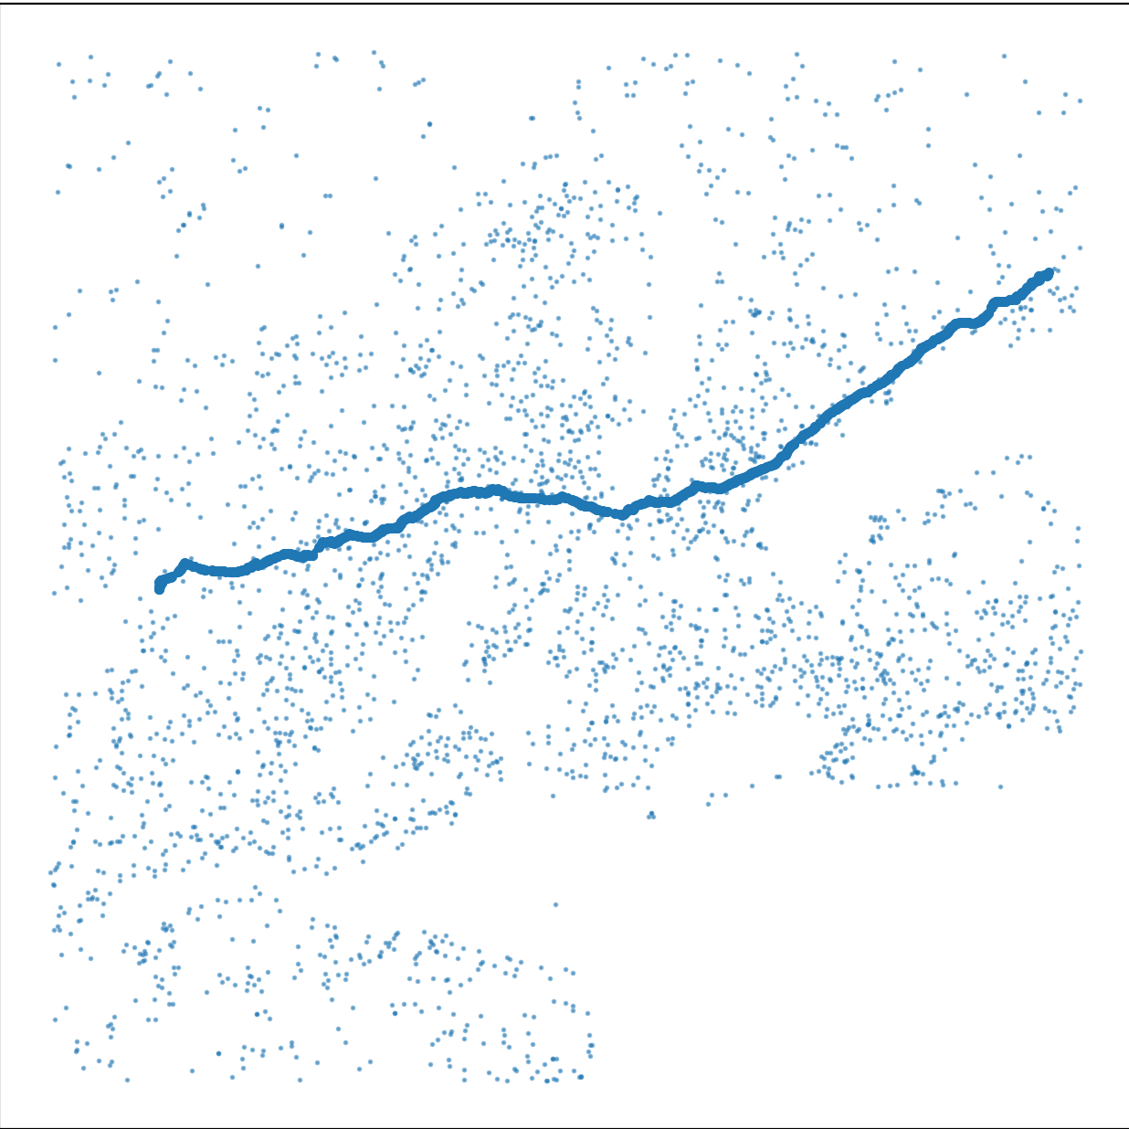
A* Algorithm Results:
Long path:
Start node: 1
Ending node: 100,000
Path length (in nodes): 874
Total path cost: 960819.0
Time taken: 0.198317 seconds
Analysis:
Due to the geographical distance being a lot larger, the A* algorithm had to take a considerable amount more of time to discover the path with the lowest weight to achieve the quickest path because of how many new possible weighted paths there are.

Slide 11

Bellman-Ford Algorithm:
Dynamic Programming
Solves Issue With Negative Edges
Uses “Relaxing On Edges” | v - 1|

Slide 12
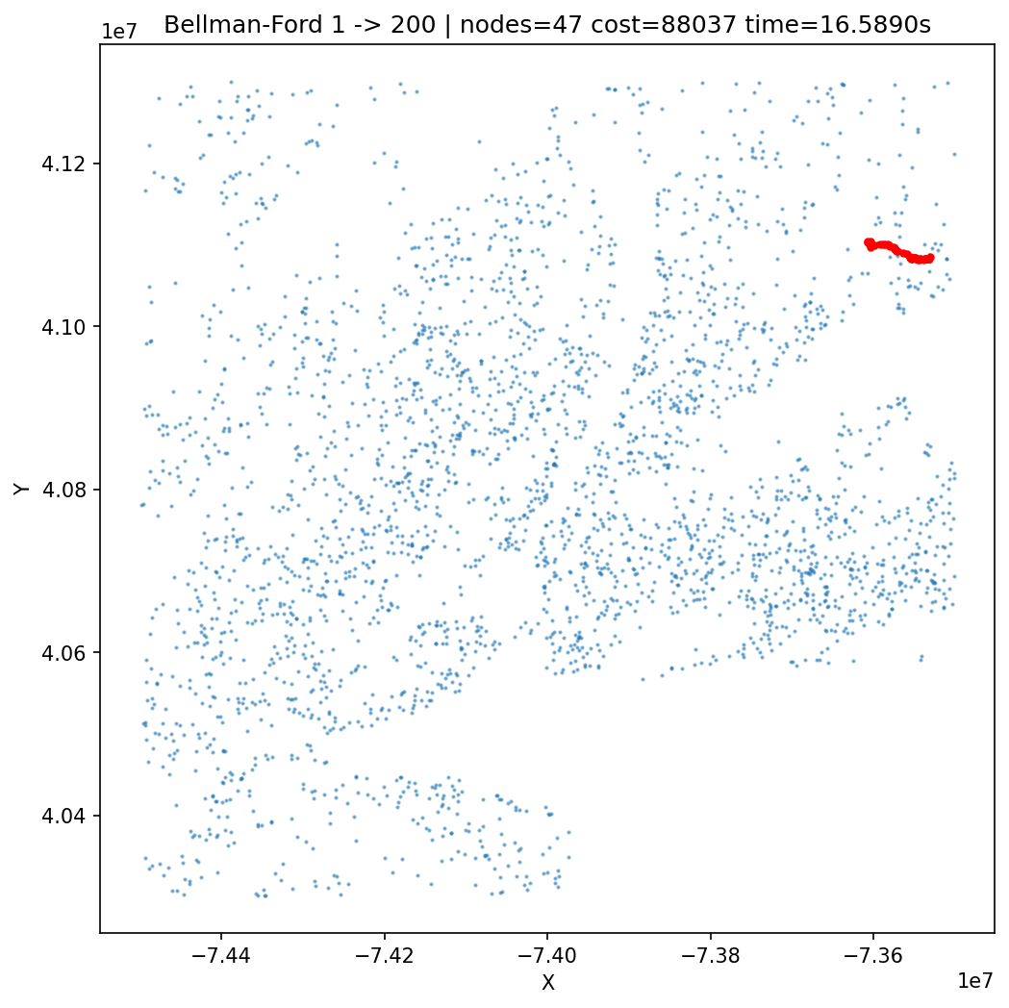
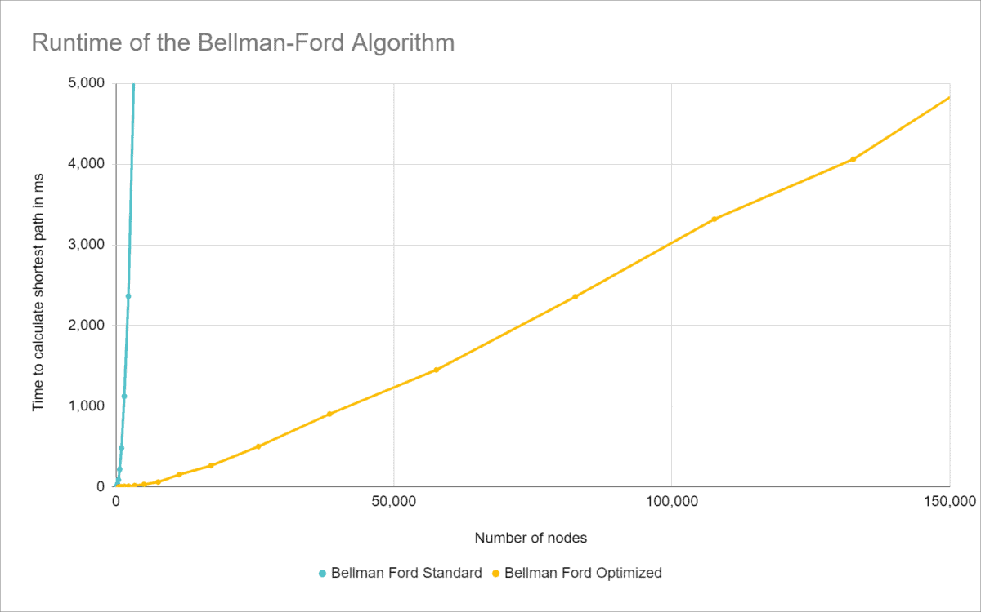
Bellman-Ford Algorithm:
For Short Paths ( 1 - 200 Nodes)
Path Length: 47
Path Cost: 88037.0
Time : 1.609913 seconds
Long Path ( 1 - 100,000 Nodes)
Path Length: 814
Path Cost : 955712.0
Time: 17.226191 seconds

Slide 13
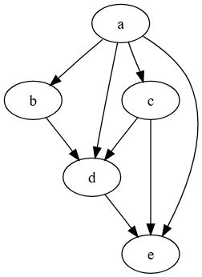
DAG Algorithm:
Finds the shortest path between nodes in an acyclic, weighted graph (DAG’s)
Handled in Topological Order
Complexity: O(V + E)
Works with negative edges

Slide 14
DAG Algorithm Issues:
New York City roads ARE cyclic
DAG requires the graph to be acyclic
Unable to be properly compared

Slide 15
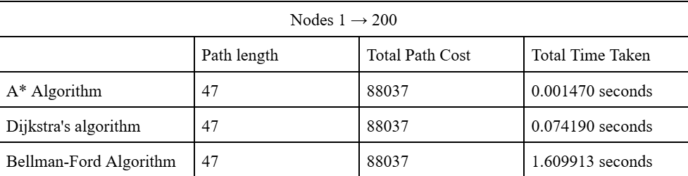
Nodes 1 -> 200
On small graphs, even though all algorithms found the same path, A* is by far the most efficient of the three. The massive jump in time-taken with Bellman-Ford shows how computational heavy it is, even at a low count of nodes.

Slide 16
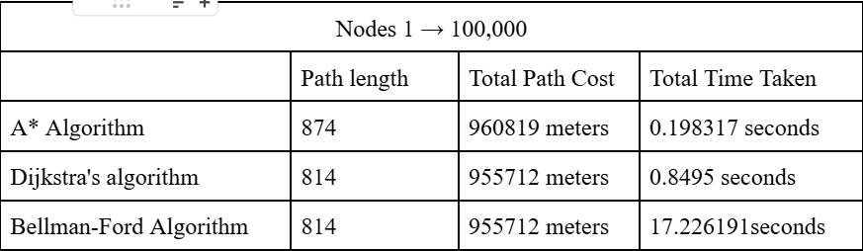
Nodes 1 -> 100,000
Bellman-Ford remains in last by still costing more and taking roughly 20x longer than Dijkstra. However, it crossed less nodes, but due to it costing more it is still not more efficient than A* or Dijkstra.

Slide 17
Key Takeaways
A* is the clear winner for both the smaller and larger datasets that were used.
Dijkstra is reliable and reasonably fast, but becomes slower as the graph size grows
Bellman-Ford is too slow for larger scale needs.
However, it is still your best option if negative weights exist due to A* and Dijkstra’s inability to work with those. due to it costing more it is still not more efficient than A* or Dijkstra.

Slide 18
The End

